Slide 1
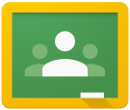
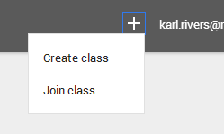
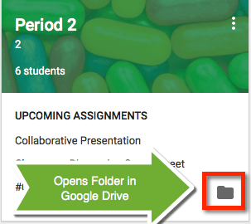
Google Classroom Shortcuts
Classroom.google.com
Go to the classroom website and login with your google apps email login
Join a Class
In the upper right click on the plus button to join a class. Enter the class code.
Google Drive
Google Classroom connects with your Google Drive account. A classroom folder has been created in drive.google.com
1
2
Class Tiles
Click Class title to
enter the class.
Click the three dots
unenroll from class.
Link to upcoming
assignments right
on the class tile.
Link to your class
folder in your
Google Drive
1
2
3
3
4
4

Slide 2
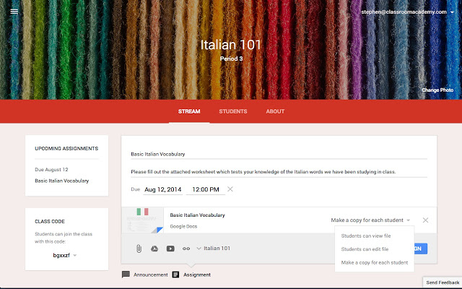
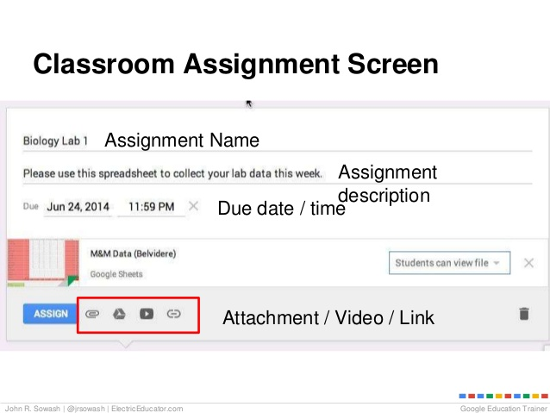
Click the three lines (upper left) to go back to the class tiles screen.
Click the envelope icon to email Mrs. Kelly.
View a list of all assignments.
Click “Upcoming Assignments” to view details and submit.
View the list of announcements, assignments and comments in the
stream.
View a list of your classmates.
The about tab contains information about the class. It will include the
class syllabus, calendar and current power point notes.
1
2
5
6
7
3
4
1
2
3
4
5
6
7
View Assignment Details
From the stream or by clicking on the assignment tile you can view assignment directions.
Open Templates
From the stream always click on “OPEN” in an assignment to view templates the teacher has created.
ASSIGNMENT DETAILS ASSIGNMENT

Slide 3
Comments Posted to the Stream are Viewable to Everyone in the class
Comments Posted to the Assignment are Viewable only by the Teacher

Slide 4
